Slide 1

Dynamics of Vehicles Project
Team 2
Students:
Vedovelli Daniele (231498), Cavalieri Nicolo’ (231202)
Supervisors:
Biral Francesco, Taddei Sebastiano

Slide 2
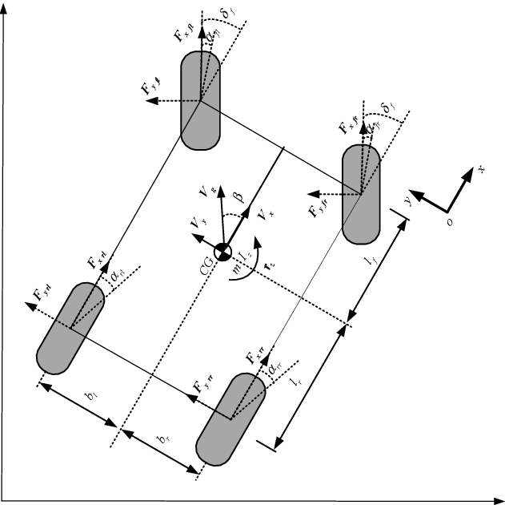
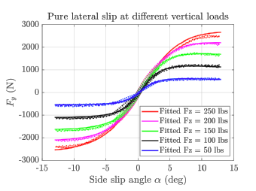
The project was composed by 2 sub-projects
Tyre data fitting analysis: fitted the MF96 tyre model coefficients on a dataset of measured tyre forces for a F-SAE tyre
Steady State Handling analysis: analysis of the steady state behaviour of a F-SAE formula type car
Double-track model of the vehicle lateral dynamics

Slide 3
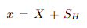
Tyre data fitting analysis
To study the tyre data fitting of the data provided we used the so called Magic Formula ‘96 Tyre Model developed by Hans B. Pacejka. In particular this is a widely used semi-empirical tyre model able to calculate steady-state tyre forces and moments characteristics. Furthermore, it is an accurate and numerically efficient model able to fit well experimental data while considering the main features of a physical model like the Brush Model.
In particular this type of model is based on 6 main factors/parameters which are:
B (Stiffness Factor): determines the slope at the origin
C (Shape Factor)
D (Peak Value)
E (Curvature Factor): controls the curvature at the peak and its horizontal position
Sh (Horizontal Shift)
Sv (Vertical Shift)
with Y(X) the output variable Fx or Fy (pure lateral or longitudinal forces) and X the input variable α
or κ (practical slip)

Slide 4
Magic Formula Tyre Model ‘96
Magic Formula ‘96 is based on the Similarity method (Pacejka 1958) which builds upon the Reference Conditions defined as a tyre running with the following properties:
rated nominal load (Fz0)
null camber (γ = 0)
free rolling (κ = 0) or null side slip (α = 0)
given road surface
As can be seen next, the provided experimental data were fitted with the formulas in the next slides with a least-square approach.

Slide 5
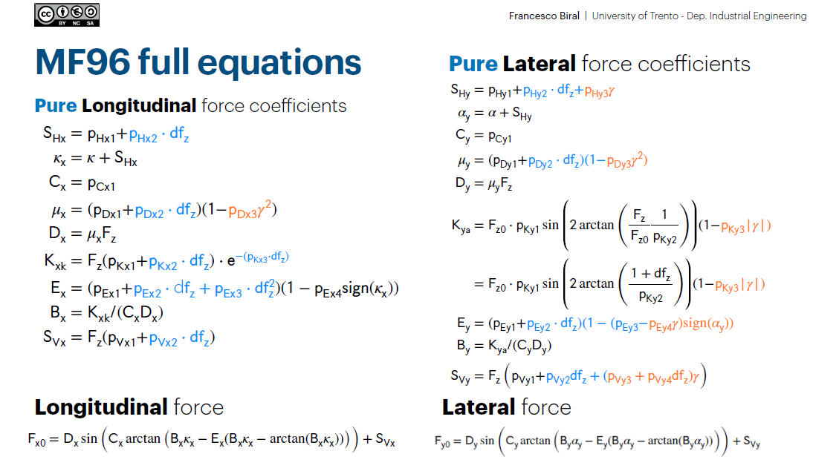

Slide 6
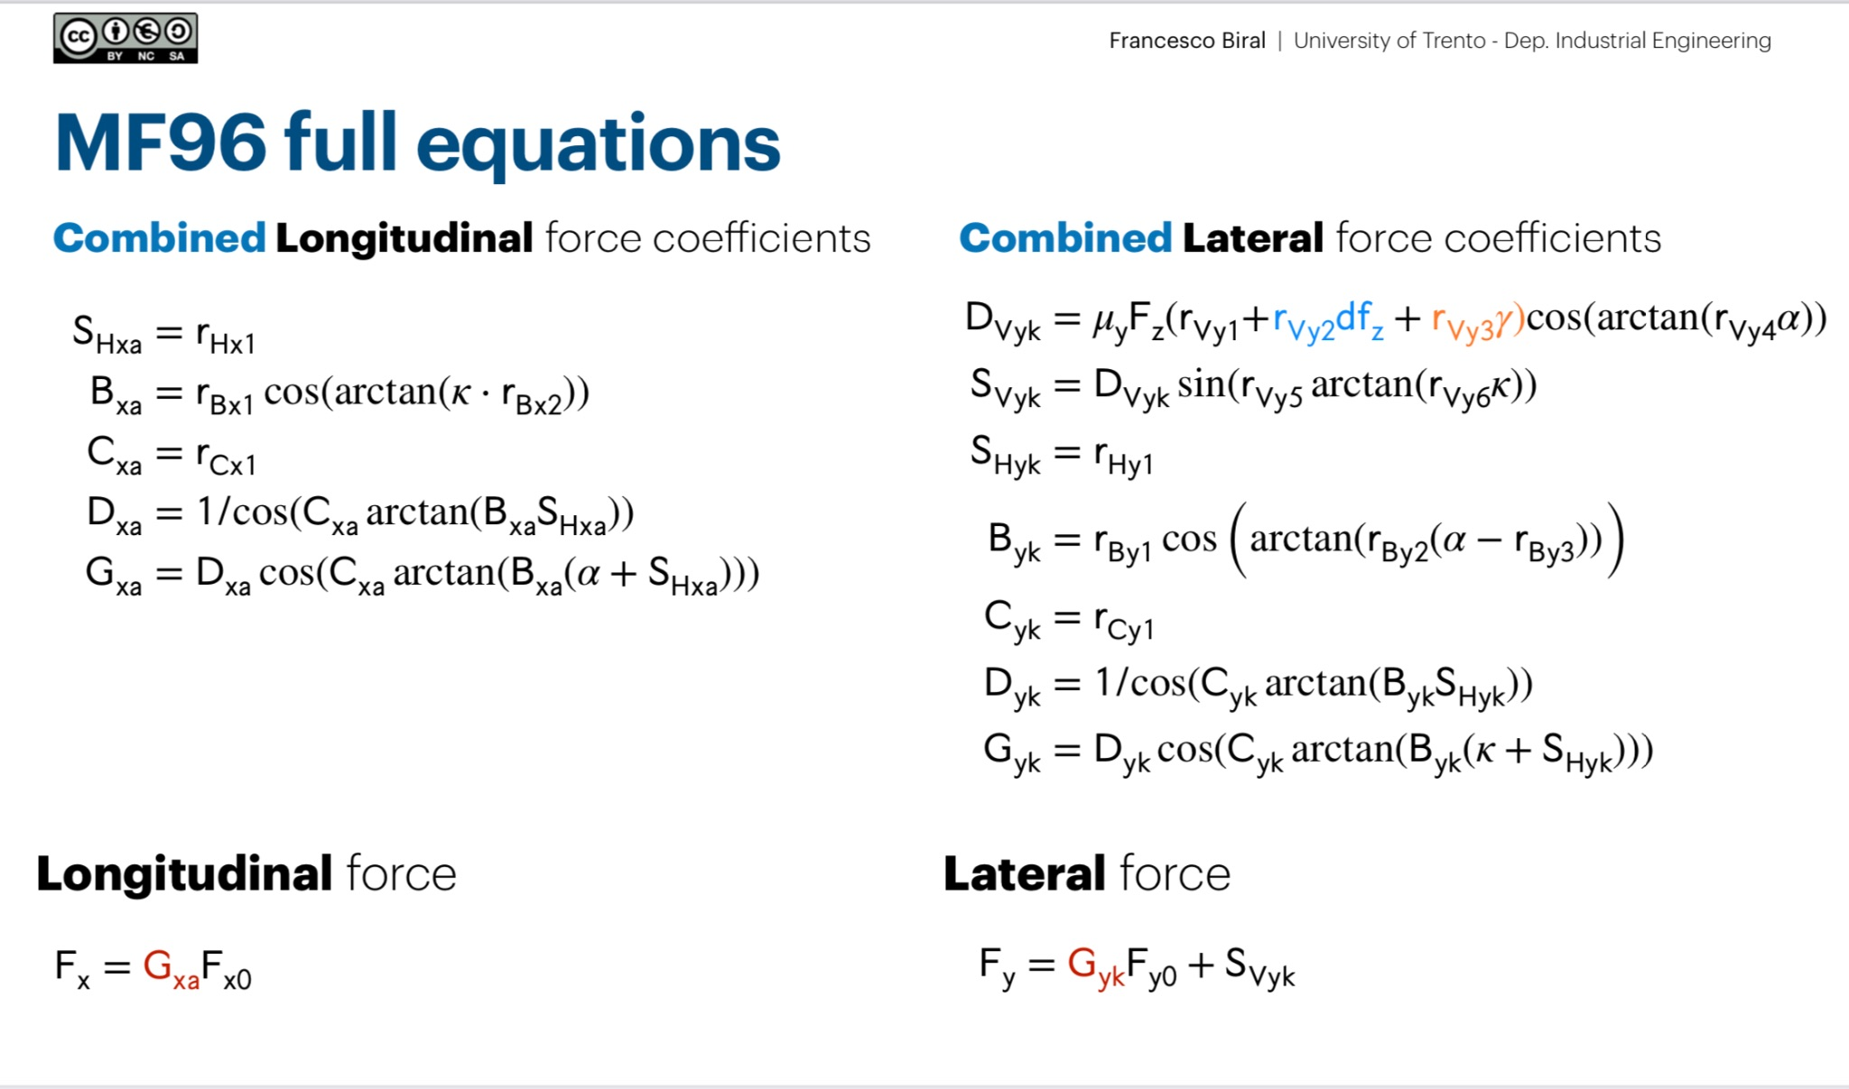

Slide 7
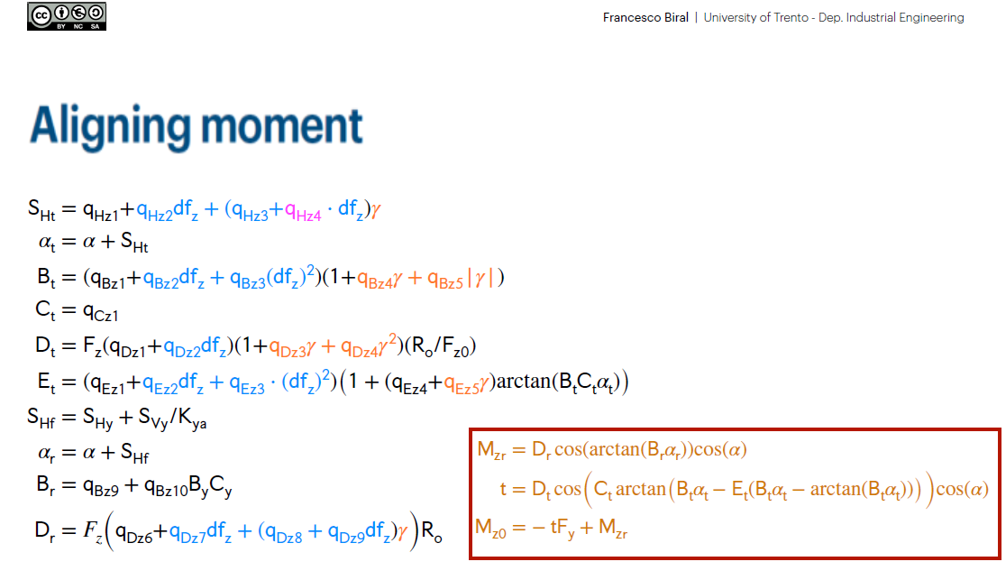

Slide 8
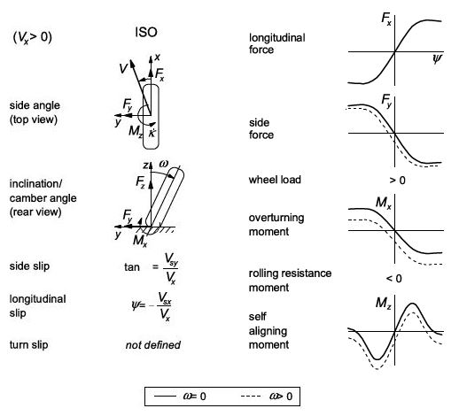
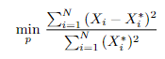
Fitting procedure description
A least-squares approach was used as parameter identification problem to find the optimal parameters that minimize the squares of the residuals between the fitted-predicted function Xi and the real experimental data Xi*
with N being the total number of samples and Xi the longitudinal, lateral force or the aligning moment.
Hoosier 18.0 x 6.0 - 10 R25B
Selected tyre type

Slide 9
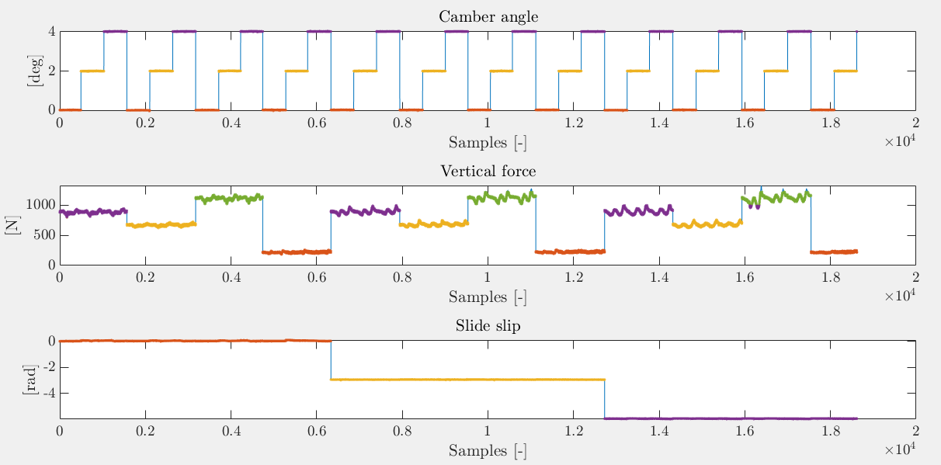
Fitting procedure description
Data cropping: selected data inside Hoosier_B1464run23.mat (related to the identification of lateral force and self-aligning moment) and Hoosier_B1464run30.mat (related to the identification of combined behaviour and pure longitudinal force)
Set of conditions for each analysis: pure longitudinal force, pure lateral force, combined pure lateral force, combined pure longitudinal force, self-aligning moment
Optimization of the residuals using fmincon as non-linear Optimization Solver
Initial guesses and boundaries vectors for the parameters to be optimized
Save tyre data struct with all the fitted tyre coefficients for MF96
Data cropping

Slide 10
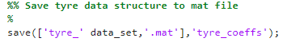
Fitted tyre coefficients for MF96
All the coefficients for each case will be shown in the next slides together with some statistical factor such as R^2 and Root Mean Square Error and the relative plots.

Slide 11
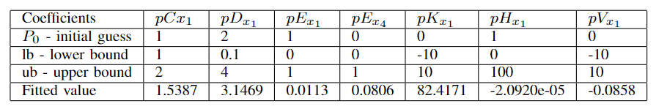
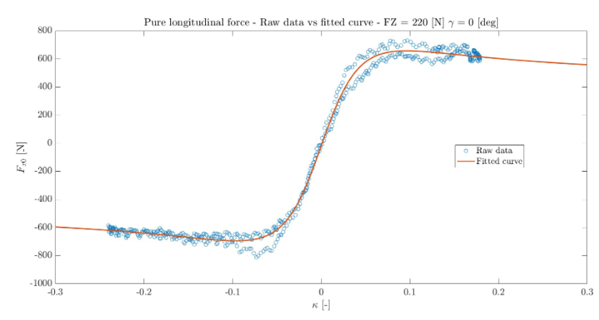
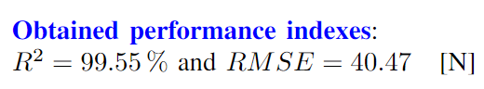
Pure Longitudinal Force
Fz0 = 220 [N] (nominal vertical load)

Slide 12
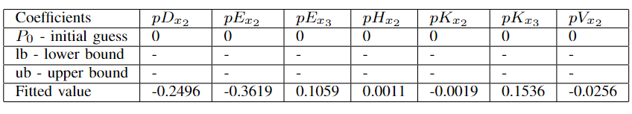
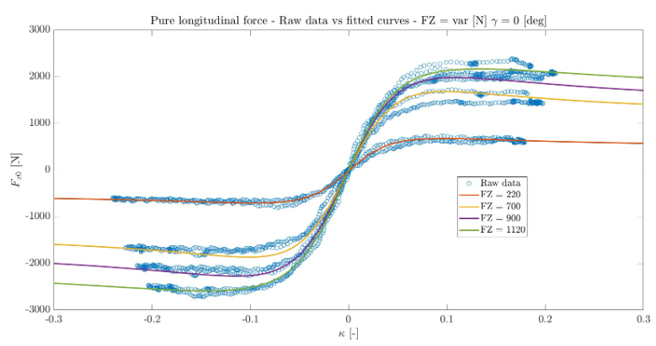
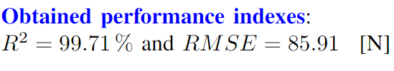
Pure Longitudinal Force (vertical load change)

Slide 13
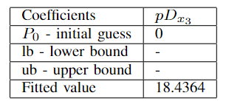
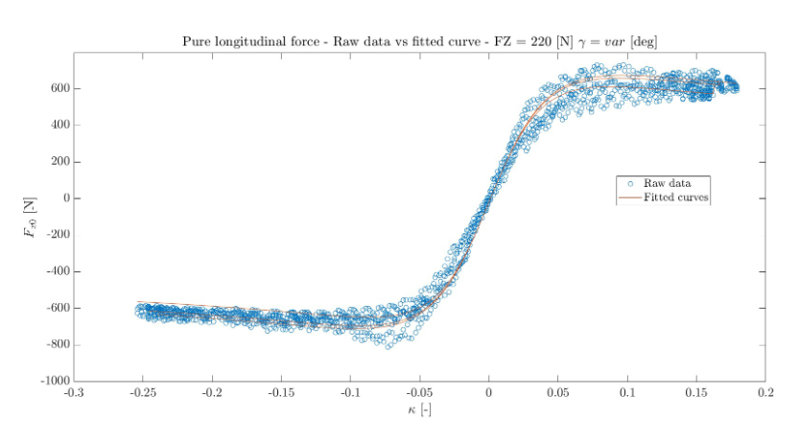
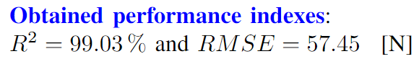
Pure Longitudinal Force (camber angle change)

Slide 14
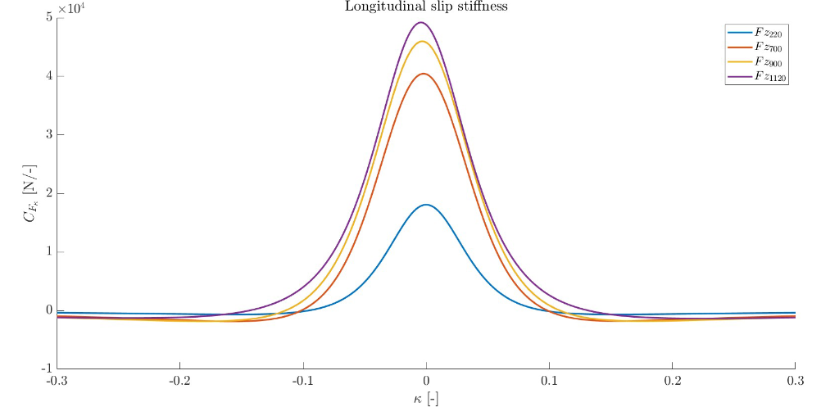
Longitudinal cornering stiffness

Slide 15
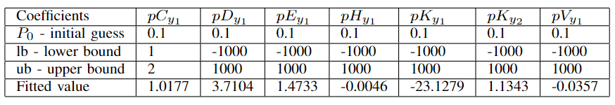
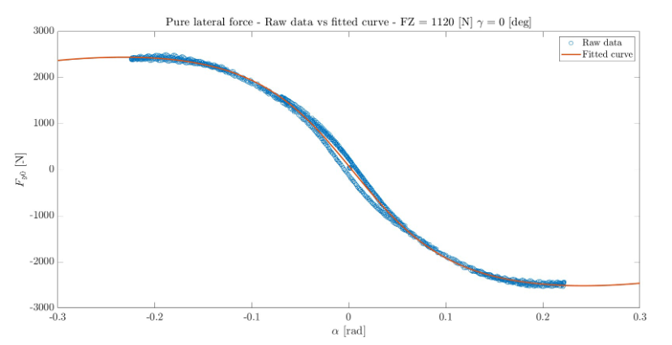
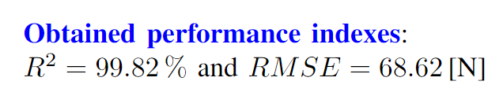
Pure Lateral Force
Fz0 = 1120 [N]

Slide 16
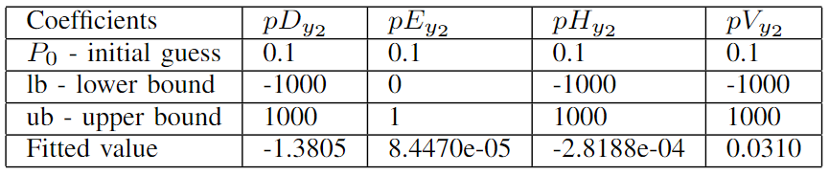
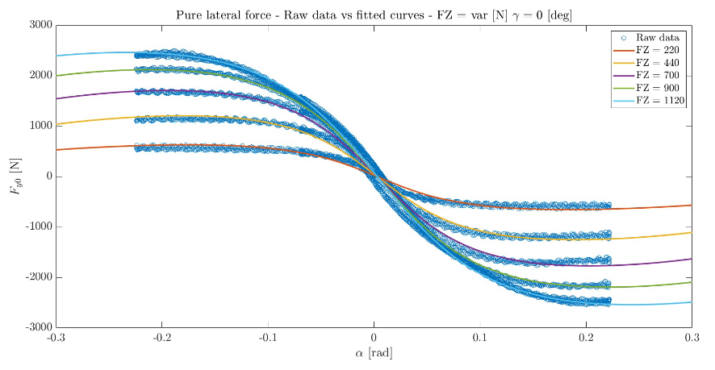
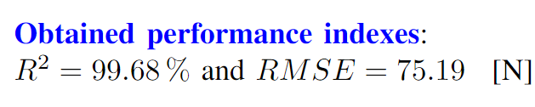
Pure Lateral Force (vertical load change)

Slide 17
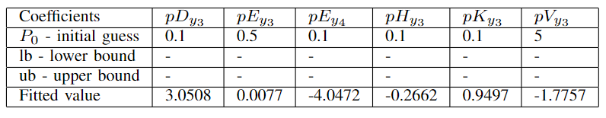
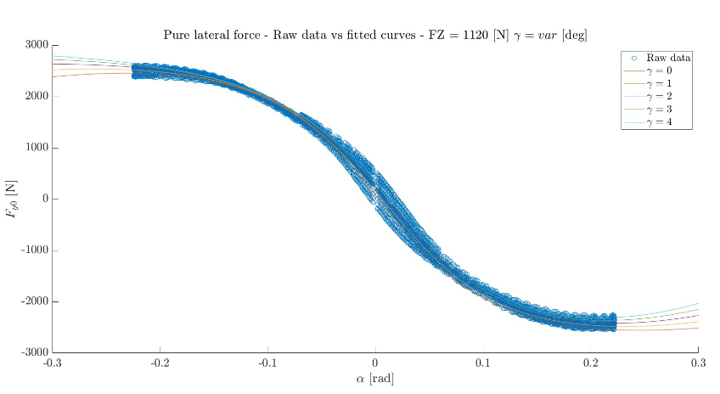
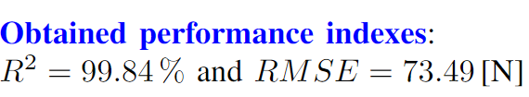
Pure Lateral Force (camber angle change)

Slide 18
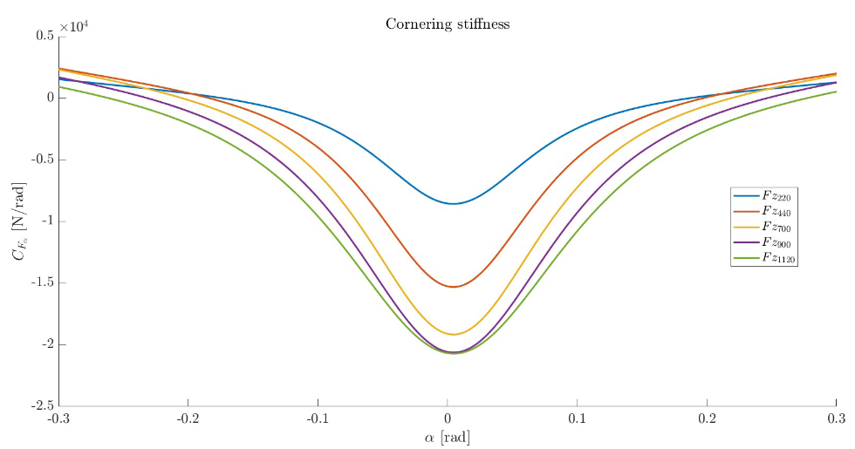
Lateral cornering stiffness

Slide 19
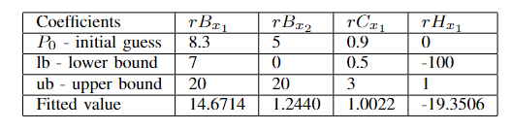
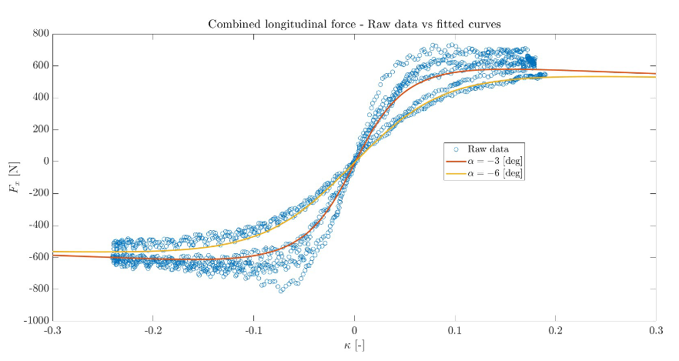
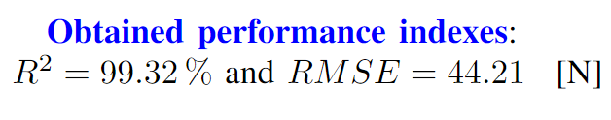
Combined Longitudinal Force
Fz0 = 220 [N]

Slide 20
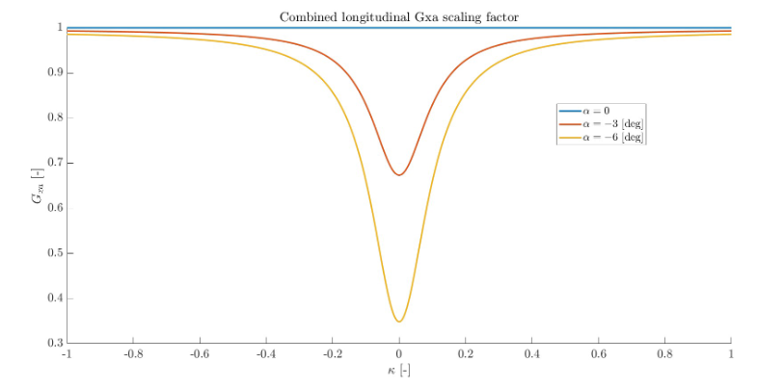
Gxa weighting function of the longitudinal force

Slide 21
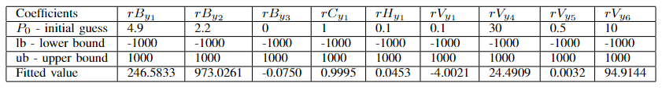
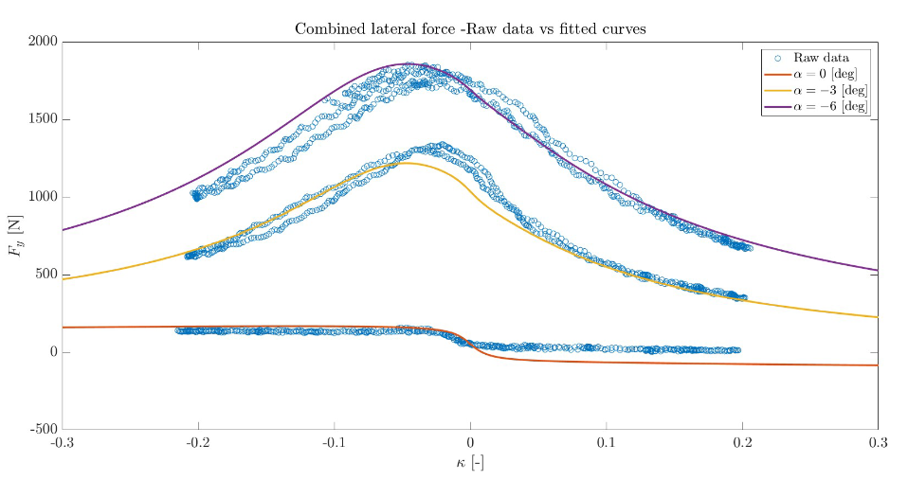
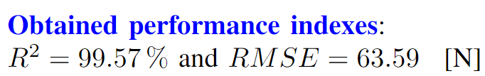
Combined Lateral Force
Fz0 = 900 [N]

Slide 22
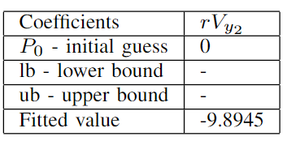
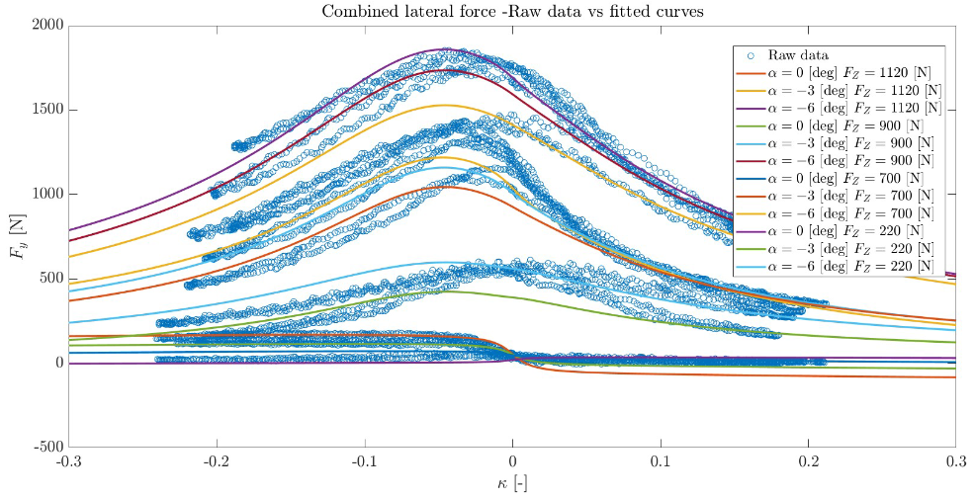
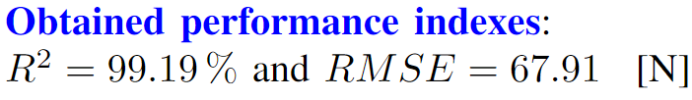
Combined Lateral Force (vertical load change)

Slide 23
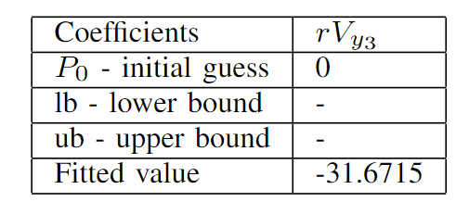
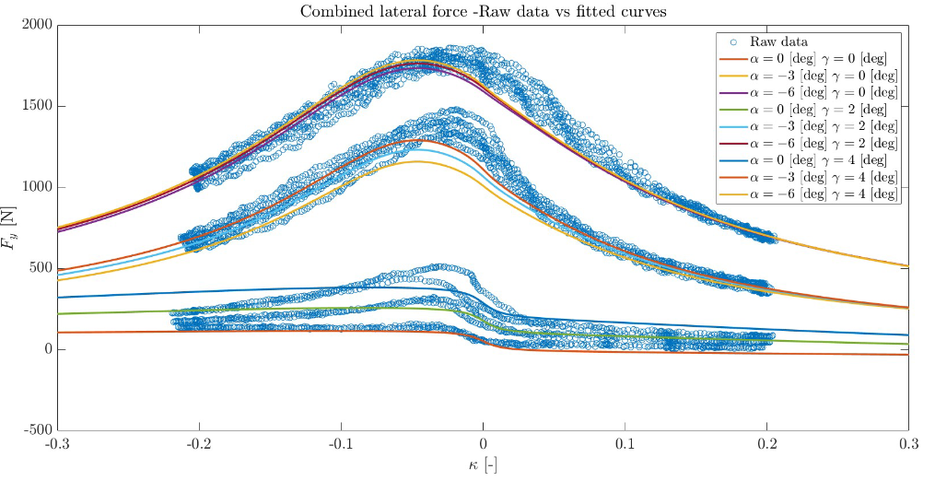
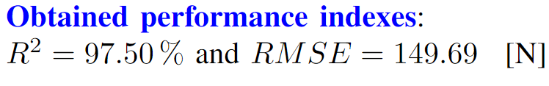
Combined Lateral Force (camber angle change)

Slide 24
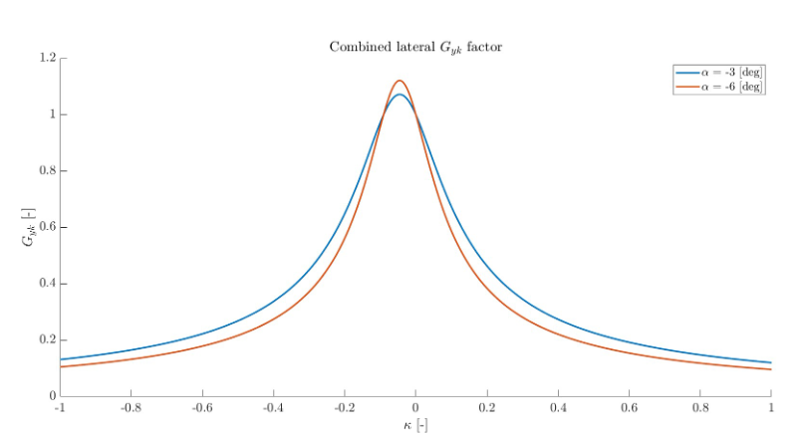
Gyk weighting function of the lateral force

Slide 25
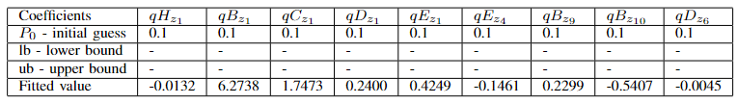
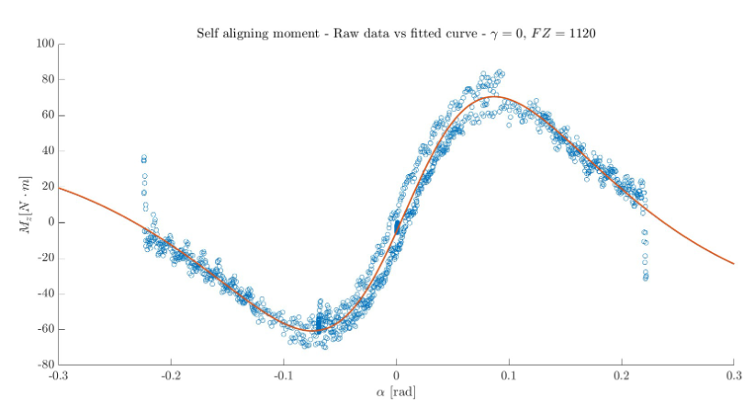
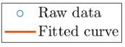
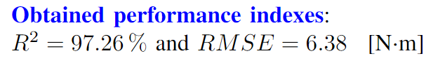
Self-Aligning Moment
Fz0 = 1120 [N]

Slide 26
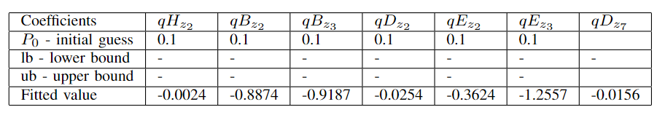
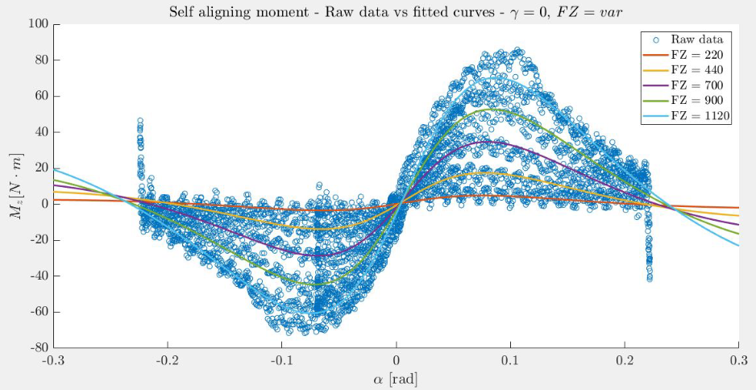

Self-Aligning Moment (vertical load change)

Slide 27



Self-Aligning Moment (camber angle change)

Slide 28

Steady-State Handling Analysis
For the study of the Steady-state behaviour of the F-SAE car provided to us we used the so called Double Track Model or 8 DoFs model, a vehicle model for performance analysis.
This model allows to study the lateral and longitudinal vehicle response together with the combined behaviour of the vehicle. In particular, it is very suited to analyze how the changes of the main system components or parameters affect the vehicle steering and traction/braking characteristics

Slide 29

Double Track Model
The model is sufficiently accurate including the major effects of all sub-systems of the vehicle.
In particular the model requirements are as follows:
Tyre characteristics
Suspension characteristics
Inertia properties
Driveline and braking system
Steering system
Most importantly the model assumptions are:
Flat road, 4 wheels, 2 axles
Negligible effects of the suspensions on the contact points positions
Roll motion (no heave and pitch motion) with roll axis not changing its pose
Front Steering system only and vertical steering axis
Small steering angle (easier equations)
Open differential (torque split equally on right and left wheel)

Slide 30


Slide 31
Goals of Steady State Handling Analysis
Modify data according the provided vehicle_data.m file and use the tyre data fitted in the first assignment
Use the vehicle model (in Simulink) to simulate the requested steady state tests such as Steer ramp test at constant speed and Speed ramp test at constant steering angle
Collect the corresponding telemetry data from the aforementioned tests
Compute main parameters and indices to evaluate the model such as:
Lateral load transfer
Normalised axle characteristics
Handling diagram
Understeering gradient (theoretical and fitted)
Yaw rate gain, Beta gain
Evaluate the effect of suspension roll stiffness, static toe angle and camber angle on steering characteristic/handling (optionally investigate the chassis roll stiffness)

Slide 32

Simulink Model implementation
Ramp blocks
Saturation blocks
Switches

Slide 33



Test #1 (Steer Ramp Test)
Constant speed: 60 Km/h
Linear steer angle ramp
Simulation ends when car starts losing control (~ 63 [s])

Slide 34

Lateral Load Transfer
We consider the case of Suspension deformation only (tyres assumed infinitely rigid) and the fact that we are in steady-state so we have neither yaw moment effect nor an angular acceleration.
Instantaneous load transfer
Elastic or transient load transfer

Slide 35



Lateral load transfer

Slide 36



Normalized axle characteristics
Front axle is able to develop higher lateral forces than the rear axle
This means that the vehicle will oversteer
Lateral forces (from simulation):
Vertical forces distribution:

Slide 37

Cornering stiffnesses from axle characteristics

Slide 38



Understeering gradient comparison

Slide 39



Handling diagram
From the lateral balance in steady state and the axle characteristics we get the axle side slips. Once we have the axle slips we are interested to find the relationship with vehicle state and in particular the trajectory curvature, the body slip and the driver steering angle.
The relationship can be found from
By making the difference between the 2 equations above we get the Steering Characteristic equation
Reshuffling the last equations we get the Handling curve equation
As we can see it is made by a linear term in the lateral acceleration and by a Non linear term which
is fitted with a polynomial function.

Slide 40

Handling diagram
Handling curves give us the steering behaviour of the vehicle as function of the normalized lateral acceleration.
Oversteering

Slide 41



Test #2 (Speed Ramp Test)
Linear speed ramp
Constant steering angle: 30°
Simulation ends when car starts losing control (~115.5 [s])

Slide 42

Lateral load transfer

Slide 43
Normalized axle characteristics
Same results as for steer ramp test
Lateral forces (from simulation):
Vertical forces distribution:

Slide 44
Cornering stiffnesses from axle characteristics

Slide 45



Understeering gradient comparison

Slide 46

Handling diagram
Handling curves give us the steering behaviour of the vehicle as function of the lateral acceleration.
Oversteering

Slide 47


Yaw rate gain

Slide 48


Beta gain

Slide 49
Additional effects analysis
Static toe angle
Camber angle
Suspension roll stiffness

Slide 50


Static toe angle effect
Positive toe

Slide 51



Camber angle effect
Positive camber
Negative camber

Slide 52



Suspension roll stiffness effect
The suspension stiffness (usually via Anti-Roll bar) affects lateral load transfer on each axle so consequently it changes the axles cornering stiffness
The elastic term or transient lateral load transfer is the part of the lateral load transfer going through the spring of the suspension deforming it
In particular we have as follows

Slide 53

Suspension roll stiffness effect

Slide 54

Thank you for the attention!!!

